Slide 2
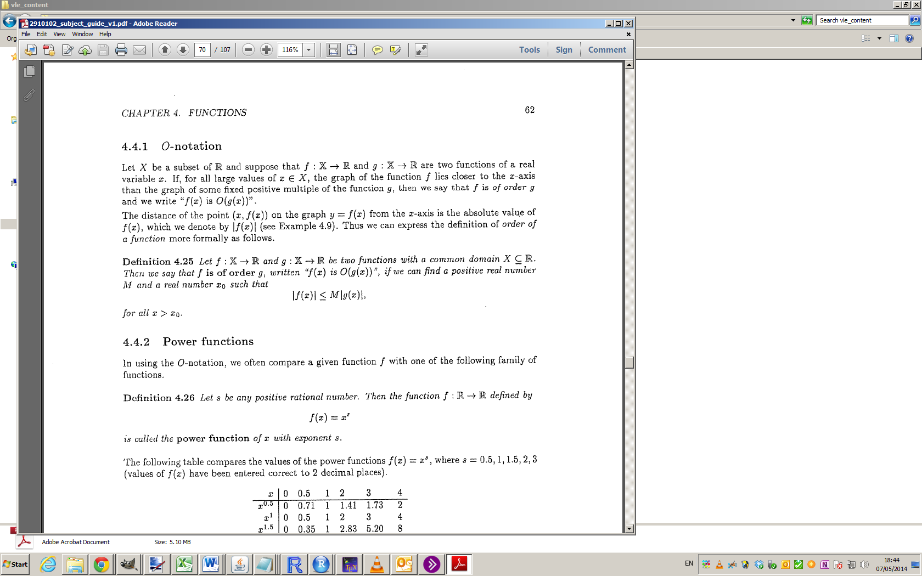
O-Notation

Slide 3
O-Notation

Slide 4
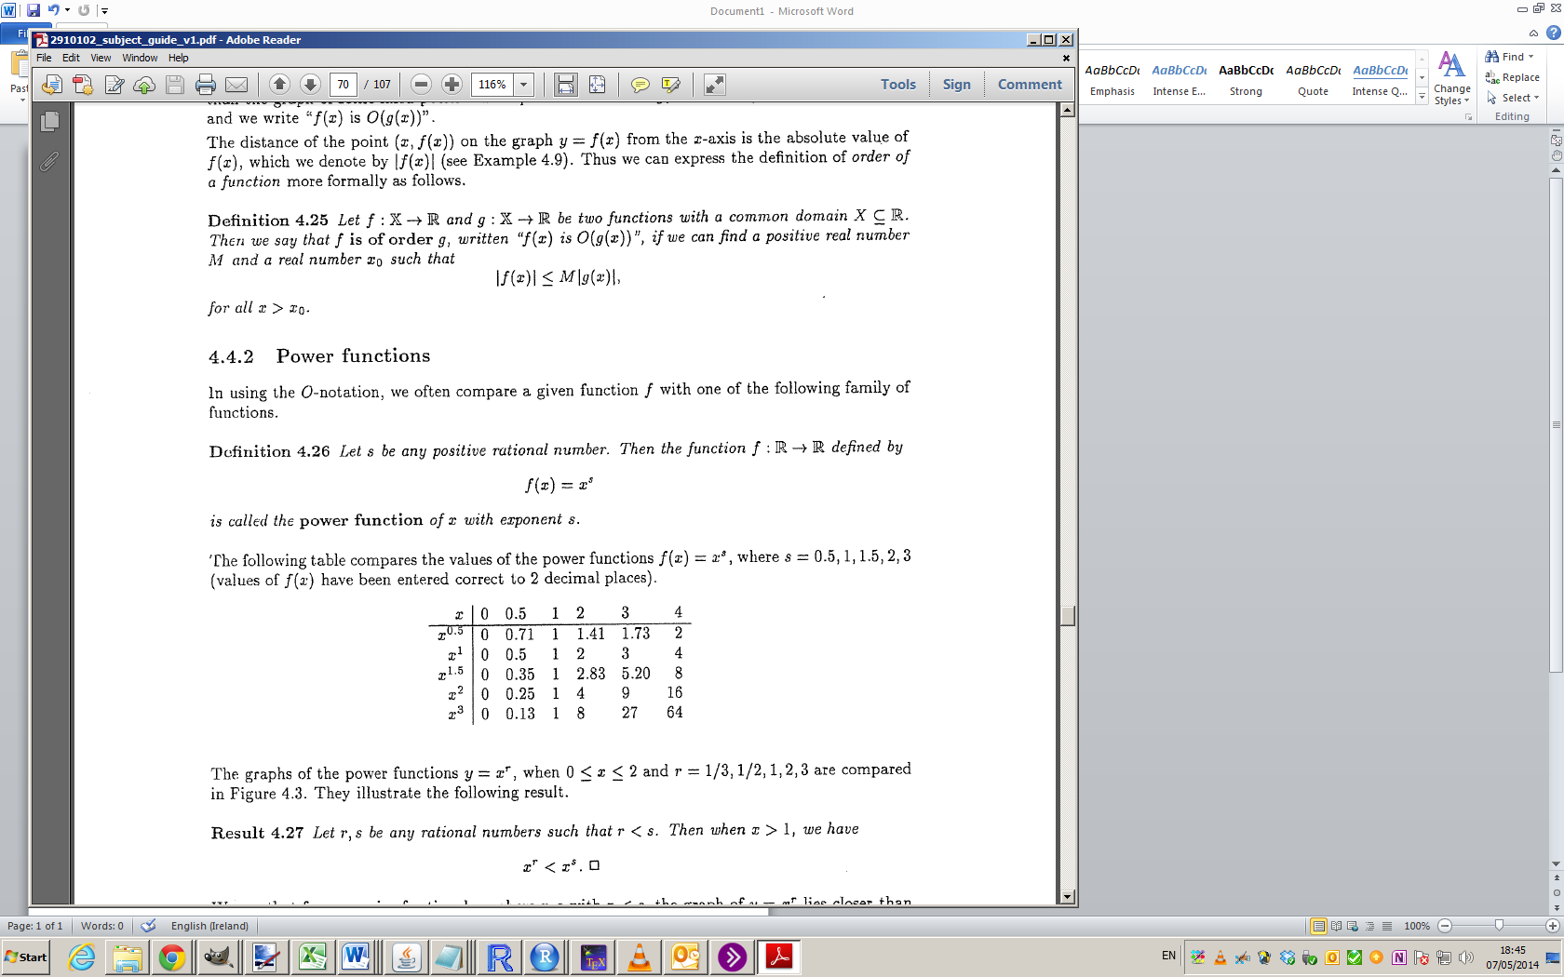
O-Notation

Slide 5
O-Notation

Slide 6
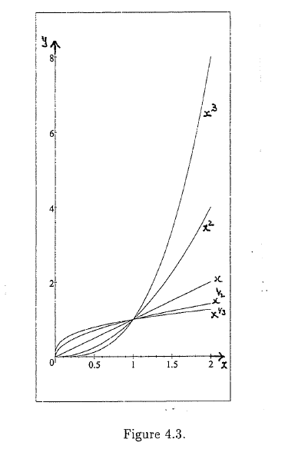
O-notation

Slide 7
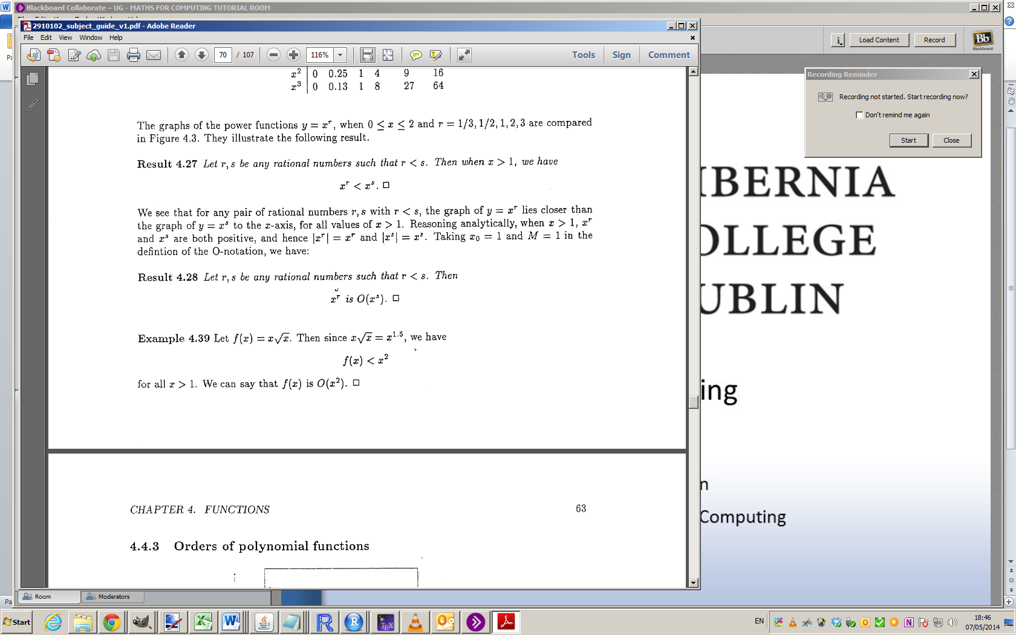
O-notation

Slide 8
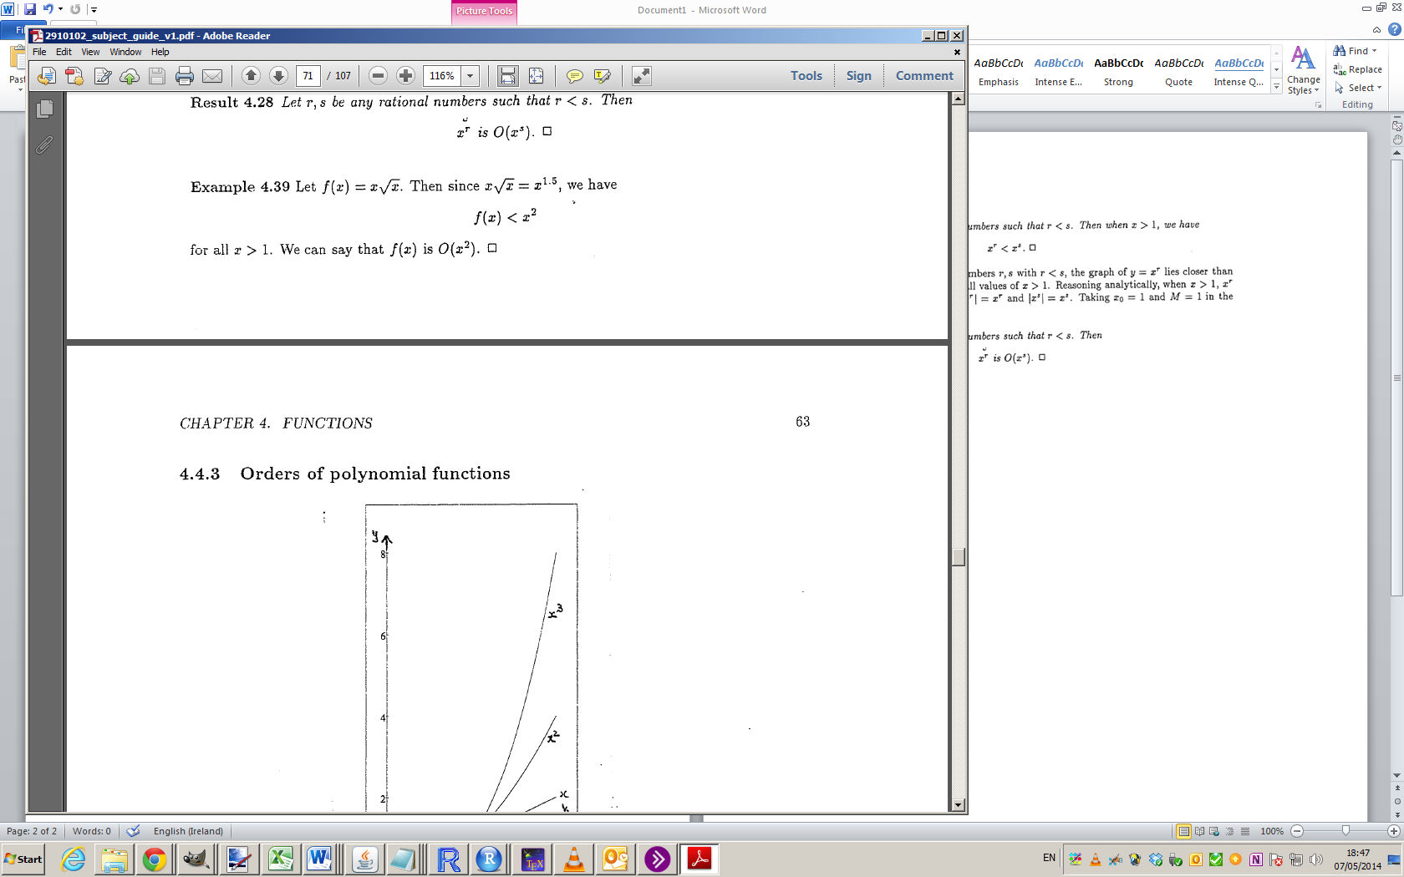
O-notation

Slide 9
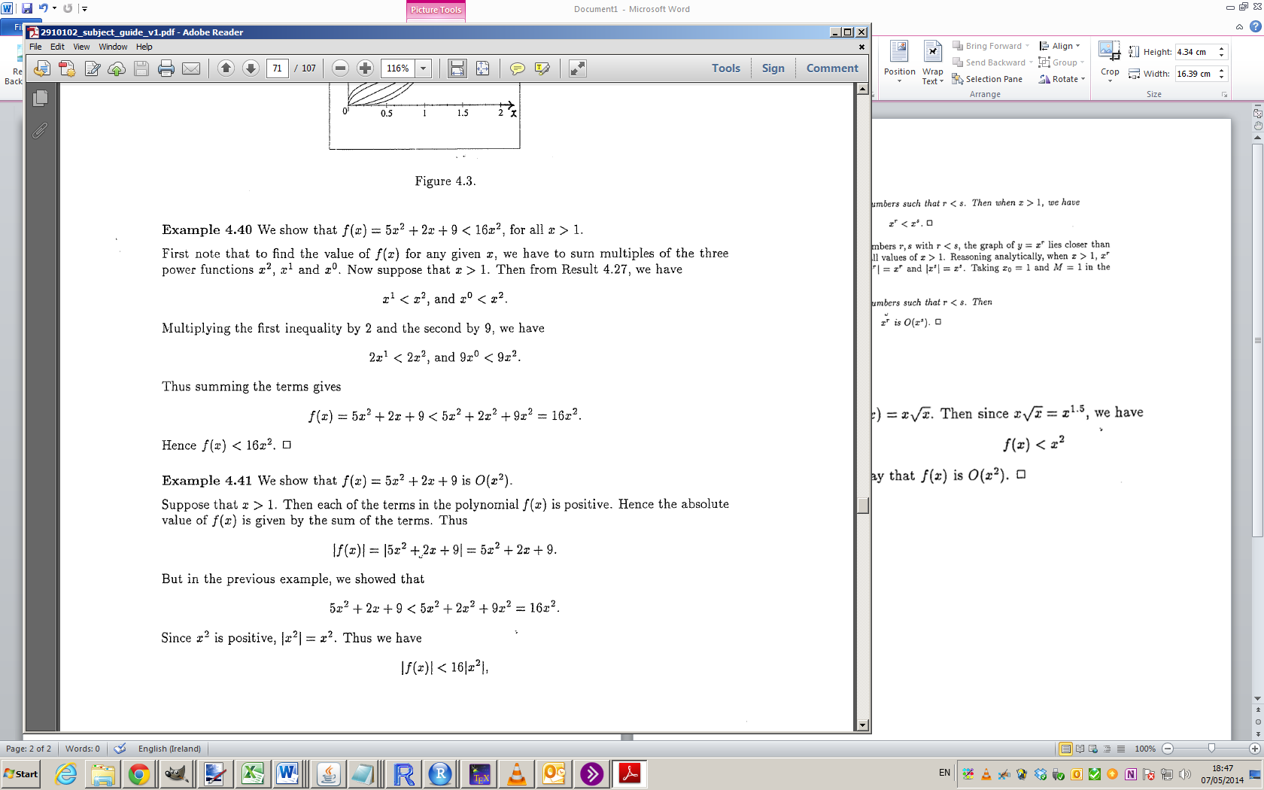
O-notation

Slide 10
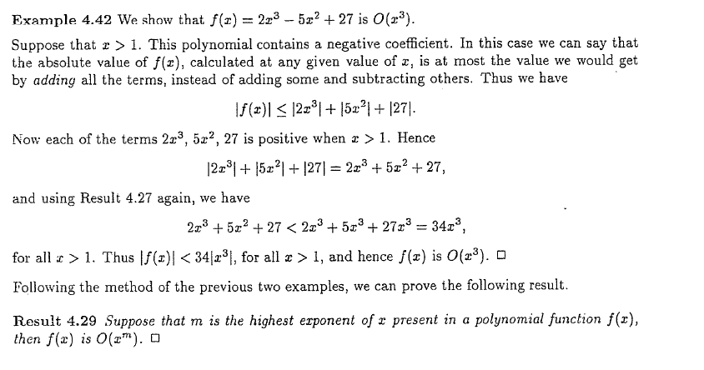
O-notation

Slide 11
Blank Page

Slide 12
Blank Page

Slide 13
Blank Page

Slide 14
Blank Page

Slide 15
Blank Page

Slide 16
Blank Page

Slide 17
Blank Page

Slide 18
Blank Page

Slide 19
Blank Page

Slide 20
Blank Page

Slide 21
Blank Page

Slide 22
Blank Page

